Slide 1
Regression Analysis of US County Premature Mortality Rate
December 04 2017
Shubham Bothara Subhadeep Roy
MATH 564

Slide 2
Overview
Project description
Data Cleaning
Data Analysis
Models
Conclusion

Slide 3
Project Description
Motivation:
County Health Rankings measure the health of all US counties.
Mortality measure YPLL (Years of Potential Life Lost) of each US county is an indicator for corrective action.
Objective:
To predict and understand the factors that correlate with YPLL.
Notes:
The major goal of the rankings is to raise awareness about many factors that influence health and subsequently take corrective actions. A good indicator of the mortality measure for each county is YPLL (years of potential life lost) which indicates the cumulative years lost (typically calculated using predefined standards) due to premature death YPLL data for each US county is available under general public license but without any supporting data. But, YPLL can be regressed if combined with external demographic data which well may act as a supporting evidence to a preventable action.

Slide 4
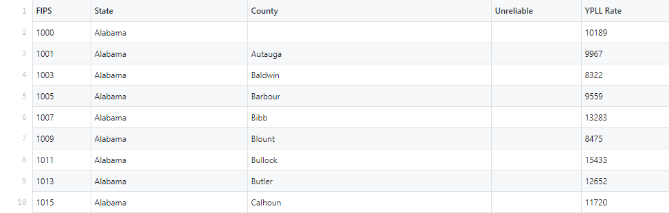
Data Cleaning
The YPLL data had the following structure:

Slide 5
Data Cleaning
The additional measures (demography) were also considered for predicting YPLL which includes:
Population
< 18
65 and over
African American
Female
Rural
%Diabetes
HIV rate
Physical Inactivity
mental health provider rate
median household income
% high housing costs
% Free lunch
% child Illiteracy
% Drive Alone

Slide 6
Data Cleaning
The records marked as unreliable were omitted
Records with cumulative state data and missing YPLL were removed
Child Literacy Rate, Rural and Free lunch had <1% missing information. So these were also dropped.
HIV Rate still had >22 % missing values. But as it is an important predictor variable, it couldn’t be ignored. It was bucketed into 5 Levels – Not Available, Very Low, Low, High, Very High.
All the predictors were assigned proper data types.
Dummy Variables were created for factor variables.

Slide 7
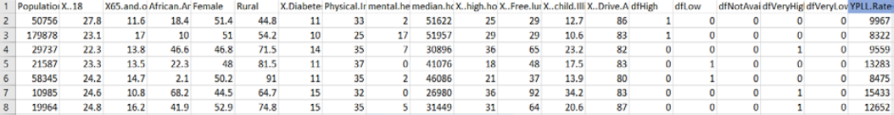
Data Cleaning
The final dataframe after cleaning looked as follows:

Slide 8
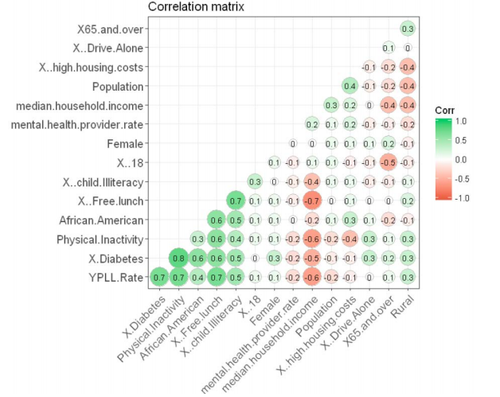
Data Analysis
Correlation plot
No high collinearity of concern
Highest collinearity observed is 0.8 which seems obvious

Slide 9
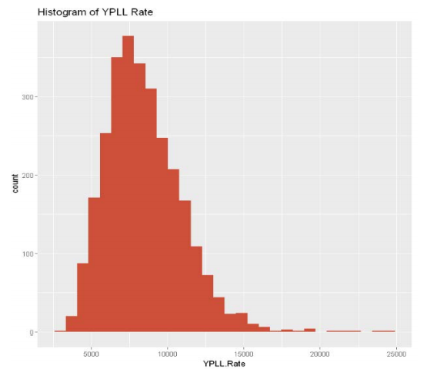
Data Analysis
Distribution of response variable.

Slide 10
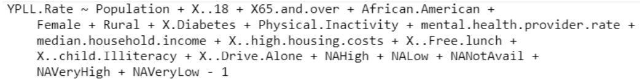
Models
Basic Regression Model
Model Formula:

Slide 11
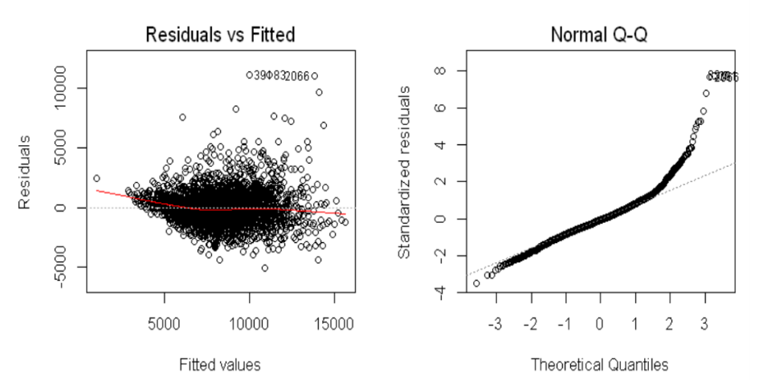
Models
Basic Regression Model
Residual plot: Variance and Normality

Slide 12
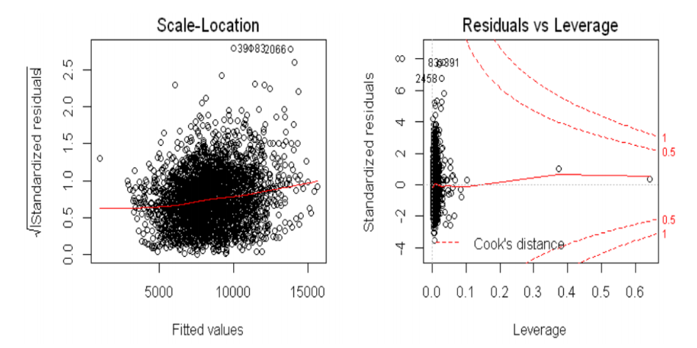
Models
Basic Regression Model
Residual plot: Variable scaling and Influential observations

Slide 13
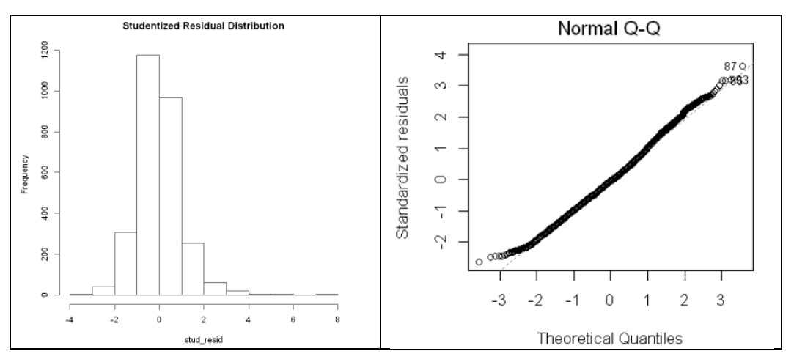
Models
Outlier Detection and Removal:
Figure 1 shows Studentized Residual Distribution
Figure 2 shows Normality after removal of outliers

Slide 14
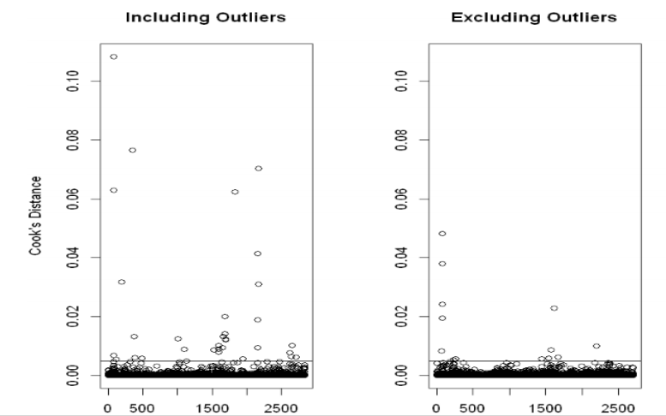
Models
Influential Observations:
Shows Influential Observations using Cook’s distance identified by a cut-off (4/n-k-1)

Slide 15
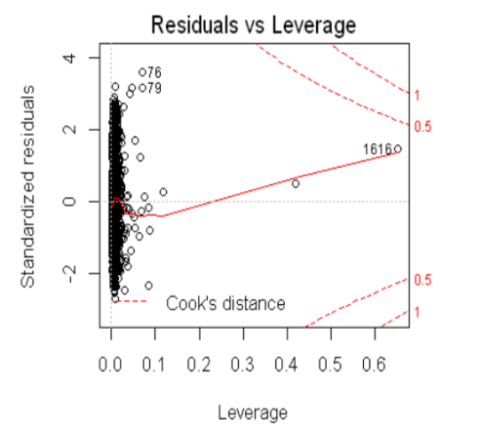
Models
Influential Observations:
Shows residual leverage after removal of influential observation.
The Cook’s boundary are more cornered.

Slide 16
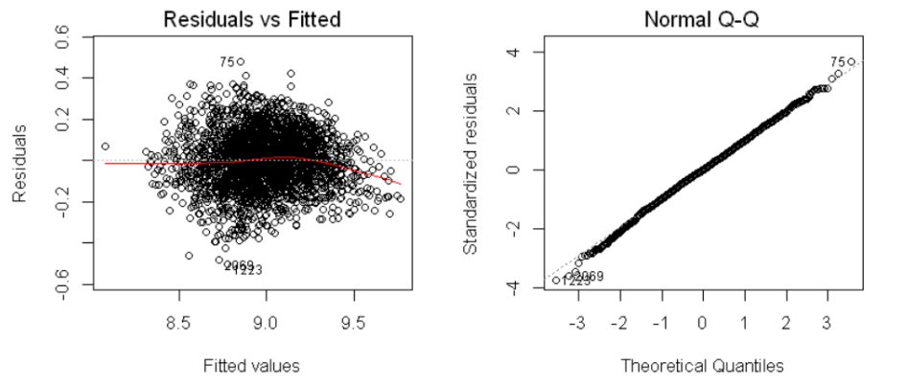
Models
Reducing heteroskedasticity (scaling):
Predictors and response variable were log scaled.
Response scaling produced the best results.

Slide 17
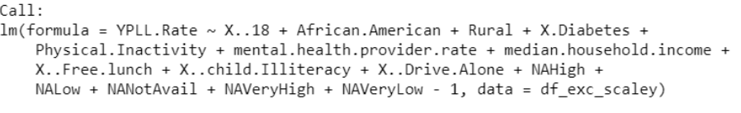
Models
Stepwise Regression:
Test if above performance can be achieved with less variables.
Bidirectional stepwise regression using minimum AIC.
Variables were reduced by 4.
Achieves Adjusted R-squared of 0.998

Slide 18
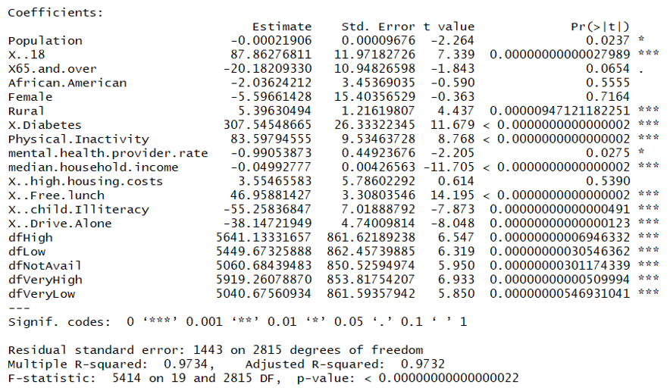
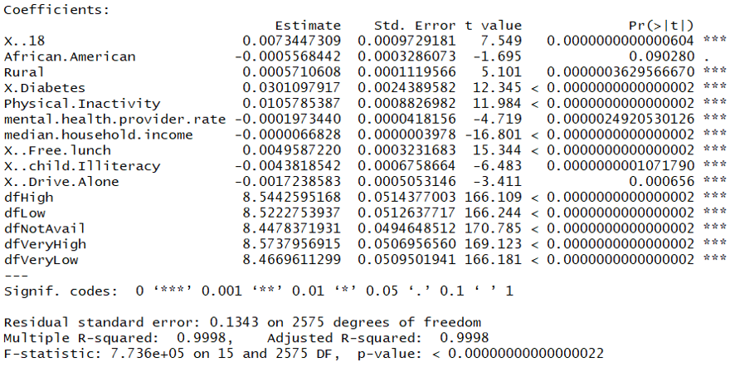
Models
Model Comparison:
Base model vs Final Model

Slide 19
Conclusion
Model performance was improved from 0.97 to 0.99 by performing residual analysis.
Chi-squared on model performance indicated stepwise performed less better than final model but at the expense of more variables.
The models were compared on residual sum of squared.
The model performance can be further checked
If HIV rate was not dummied, instead imputed using KNN.
Using different scale functions.

Slide 20
Thank You

